Slide 1

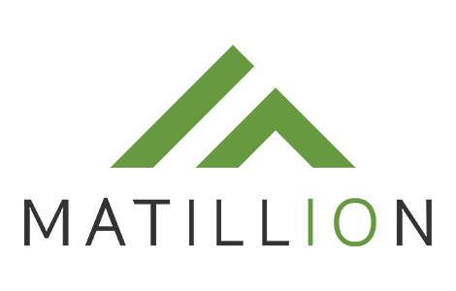
NG Data Sources (Mainframe) DXC Datacenter
1
Azure Blob Storage
Cloud Data Platform (CDP)
GoAnywhere MFT (sFTP)
CSS Code sets
Stage/Raw Layer
CSS
ODBC/JDBC
2a
Matillion (Cloud ETL)
3a
CSS Schema
CRIS
ODBC/JDBC
CSS Workflow
ODBC/JDBC
RAW
Final
Audit
Foundational Product
Layer
2b
CRIS Schema
CRIS Workflow
ODBC/JDBC
Audit
3b
RAW
Final
PowerBI
MDM Workflow
MDM Schema
Enterprise Curated DB
STG
Audit
4
ODBC/JDBC
Customer Schema
Master Data Management
MDM_DB
5
MDM Schema
Customer Materialized Views
Individual
API
Individual
Organization
Organization
Accounts
Account
6
7
Reltio Snowflake Connector (ODBC/JDBC)
ODBC/JDBC
1,2,3 | 4,5 | 6, 7
Weekly Matillion reads data from CRIS and CSS and loads to RAW schema. Also CSS code sets files are pushed to Blob storage using GoAnywhere MFT and load to Snowflake Matillion then reads data from RAW schema and loads to Final CRIS and CSS scheme and audit trail is kept in CRIS and CSS Audit Schemas Snowflake data access is completely control by AD role based access | For routing data to Reltio MDM, Matillion invokes REST API calls which populates Reltio proprietary No-SQL schema. Each Reltio user has Azure AD Role based access Reltio manages Client ID and secret for REST API calls | Reltio Snowflake Service Account user has permission to manage tables and INSERT/UPDATE/DELETE access on those tables in Enterprise DB Reltio is internally hosted in AWS. To facilitate its interaction with Snowflake (hosted in Azure), IP whitelisting has been implemented. Refer to the below attached document for details on the Snowflake connector.
<ENV>_CDP_DB

